Slide 1
Interest Flooding Attack and Countermeasures in Named Data Networking
Authors: Alexander Afanasyev, Priya Mahadevany, Ilya Moiseenko, Ersin Uzuny, Lixia Zhang
Publisher: IFIP Networking, 2013
(International Federation for Information Processing)
Presenter: Chia-Yi, Chu
Date: 2013/11/27

Slide 2
Outline
Introduction
NDN Overview
Interest Flooding Attacks in NDN
Interest Flooding Mitigation Methods
Evaluation of Interest Flooding Mitigation Methods

Slide 3
Introduction (1/1)
Provides 3 mitigation algorithms to mitigate Interest flooding
Interest flooding
malicious users can attack the network by sending an excessive number of Interests. Since each Interest consumes resources at intermediate routers as it is routed through the network, an excessive number of Interests can congest the network and exhaust a router’s memory.

Slide 4
NDN Overview (1/2)
A receiver-driven, data-centric communication protocol
Communications in NDN are performed using two distinct types of packets
Interest and Data.
Both types of packets carry a name
which uniquely identifies a piece of content that can be carried in one Data packet.
content name is composed of one or more variable-length components and be delimited by “/”.
youtube video would look like: “/youtube/videos/0F8YdlkKO9A/0”.

Slide 5
NDN Overview (2/2)
NDN routers maintains three major data structures:
Pending Interest Table (PIT)
holds all “not yet satisfied” Interests that have been sent upstream towards potential data sources.
Forwarding Interest Base (FIB)
maps name prefixes to one or multiple physical network interfaces, specifying directions where Interests can be forwarded..
Content Store (CS)
temporarily buffers Data packets

Slide 6
Interest Flooding Attacks in NDN (1/4)
Interest packets in NDN are routed through the network based on content name prefixes and consume memory resources at intermediate routers.
An attacker or a set of distributed attackers can inject excessive number of Interests in an attempt to overload the network and cause service disruptions for legitimate users
A large volume of such malicious Interests can disrupt service quality in NDN network in two ways: create network congestion and exhaust resources on routers.

Slide 7
Interest Flooding Attacks in NDN (2/4)

Slide 8
Interest Flooding Attacks in NDN (3/4)
if the data producer is the exclusive owner of “/foo/bar” namespace, both router B and the data producer would receive all Interests for “/foo/bar/...” that cannot be otherwise satisfied from in-network caches.
An excessive amount of malicious Interests can lead to exhaustion of a router’s memory
NDN routers maintain per-packet states for each forwarded Interes

Slide 9
Interest Flooding Mitigation Methods (1/15)
Naïve solution
restrict the number of Interests forwarded through the network.
Simple implementation technique
To limit the number of forwarded Interests out of each interface based on the physical capacity of the corresponding interface.
a slight modification of the well-known Token Bucket algorithm

Slide 10
Interest Flooding Mitigation Methods (2/15)
routers can keep track of the amount of data requested that can fully utilize the downstream link
once the link capacity limit has been reached, they no longer forward new incoming Interests.
the number of tokens
the pending Interest Limit
$Interest Limit=Delays\left[s\right]∗\frac{Bandwidth[Bytes/s]}{Data packet size [Bytes]}$
Delay: the expected time for the Interest to be satisfied
Data packet size: the size of the returning Data packet.

Slide 11
Interest Flooding Mitigation Methods (3/15)
Drawbacks
result in underutilization of the network
not all Interests will result in a Data packet
can nourish DDoS attacks
If a router has utilized all its tokens to forward malicious Interests, it can no longer forward incoming Interests from legitimate users till the pending malicious Interests start to expire
Solution
impose a per interface fairness

Slide 12
Interest Flooding Mitigation Methods (4/15)
Token bucket with per interface fairness
extend the Pending Interest Table
to support flagging of Interests that cannot be immediately forwarded and implement hierarchical queues for each interface
not actually store a packet, but merely a bi-directional pointer to the existing PIT entry.

Slide 13
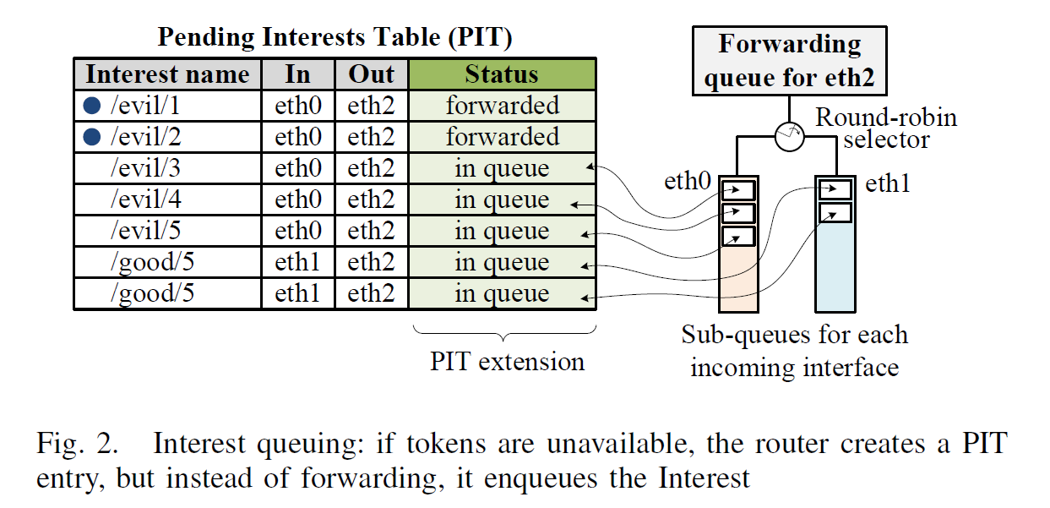
Interest Flooding Mitigation Methods (5/15)

Slide 14
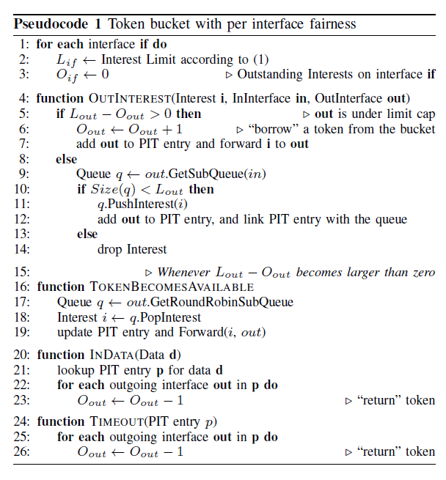
Interest Flooding Mitigation Methods (6/15)

Slide 15
Interest Flooding Mitigation Methods (7/15)
Token bucket with per interface fairness
Drawback
still admits a relatively large number of Interests from malicious users
it drops both legitimate and malicious Interests
attempts to ensure that each interface does not forward more than its fair share of Interests
Solution
be able to detect and differentiate to some extent malicious requests from legitimate ones.

Slide 16
Interest Flooding Mitigation Methods (8/15)
Intelligent attack mitigation
Routers can proactively maintain up-to-date statistics of Interest satisfaction ratios
number of forwarded versus number of satisfied Interests
use these statistics to determine whether an incoming Interest should be forwarded or dropped.
use the standard exponentially weighted moving average, performed once a second with $α$ coefficient $e^{{−1}/{30}}$, approximately corresponding to a 30-second averaging window.

Slide 17
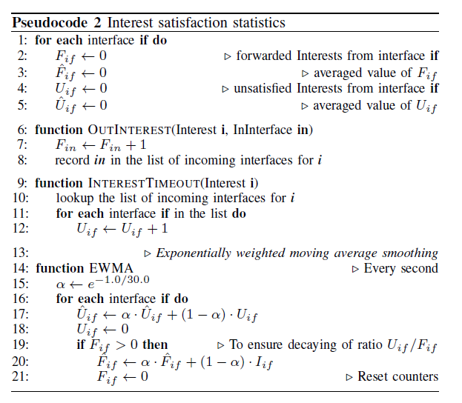
Interest Flooding Mitigation Methods (9/15)

Slide 18
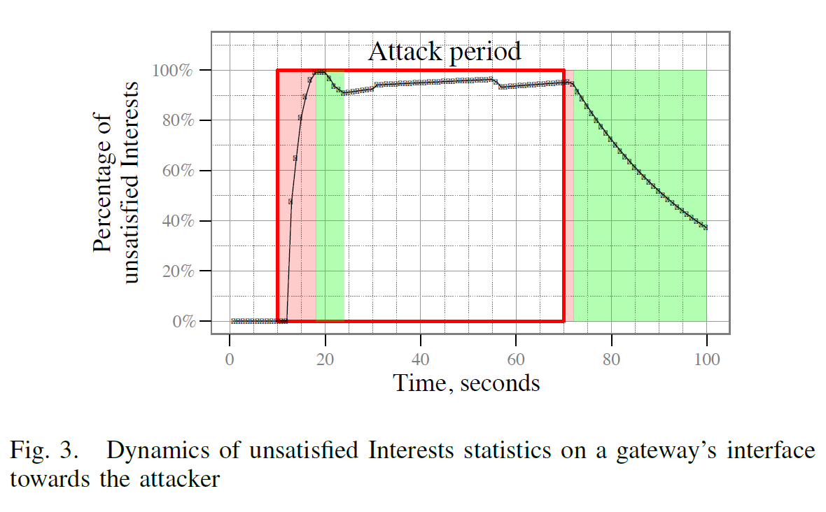
Interest Flooding Mitigation Methods (10/15)

Slide 19
Interest Flooding Mitigation Methods (11/15)
Satisfaction-based Interest acceptance
use the Interest satisfaction ratio as a direct probability for accepting (forwarding) or rejecting an incoming Interest
Parameter$θ$
ensures that the probabilistic model is not enforced when the volume of Interests arriving at a particular interface is small.
Drawback
the probability of legitimate Interests being forwarded decreases rapidly as the number of hops between the content requester and producer grows

Slide 20
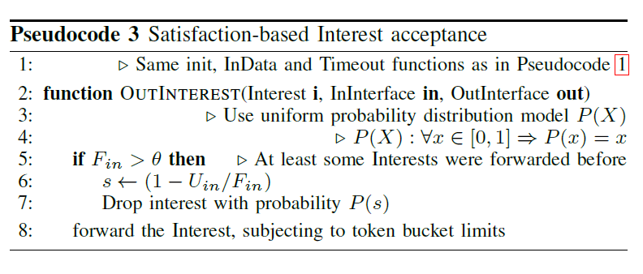
Interest Flooding Mitigation Methods (12/15)

Slide 21
Interest Flooding Mitigation Methods (13/15)
Satisfaction-based pushback
enable and enforce explicit Interest limit for each incoming interface, where the value of the limit depends directly on the interface’s Interest satisfaction ratio.
Announce these limits to their downstream neighbors
Any Interest forwarded from the downstream router is allowed to get through, resulting in genuine Interest satisfaction statistics.

Slide 22
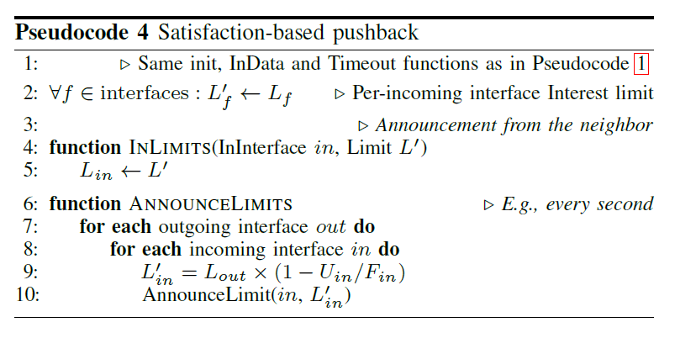
Interest Flooding Mitigation Methods (14/15)

Slide 23
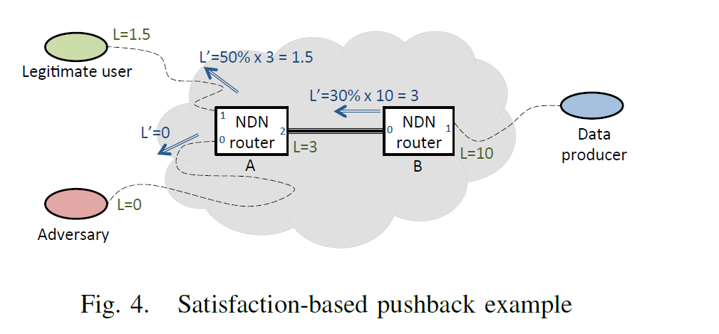
Interest Flooding Mitigation Methods (15/15)

Slide 24
Evaluation of Interest Flooding Mitigation Methods (1/13)
Use the open-source ndnSIM package
implements NDN protocol stack for NS-3 network simulator
token bucket with per interface fairness
satisfaction-based Interest acceptance
satisfaction-based pushback
To quantify the effectiveness of algorithms
percentage of satisfied Interests for legitimate users.
A high percentage of user-expressed Interests are satisfied even while the network is under attack

Slide 25
Evaluation of Interest Flooding Mitigation Methods (2/13)
Simulations on two different network topologies
Smaller binary tree topology
Larger ISP-like topology
The percentage of attackers in the network
Ranged from 6% attackers to over 50% attackers
Delay
binary tree topology: 80ms
ISP-like topology: 330ms
Data size
1100 bytes

Slide 26
Evaluation of Interest Flooding Mitigation Methods (3/13)
Small-scale evaluations
There are 16 end users
both legitimate and attackers
Each expressing Interests that are routed towards a single data producer
placed at the root of the tree.
Bandwidth of 10 Mbps
Randomized propagation delay ranging from 1 to 10 ms.

Slide 27
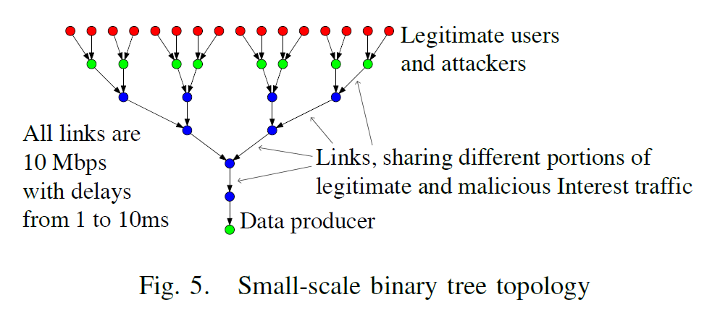
Evaluation of Interest Flooding Mitigation Methods (4/13)

Slide 28
Evaluation of Interest Flooding Mitigation Methods (5/13)
Effectiveness of the three mitigation algorithms
Perform 10 independent simulation runs
7 client nodes to represent adversaries, 9 client nodes represent legitimate users
where randomly choose
10-minute attack window
Total simulation time was 30 minutes

Slide 29
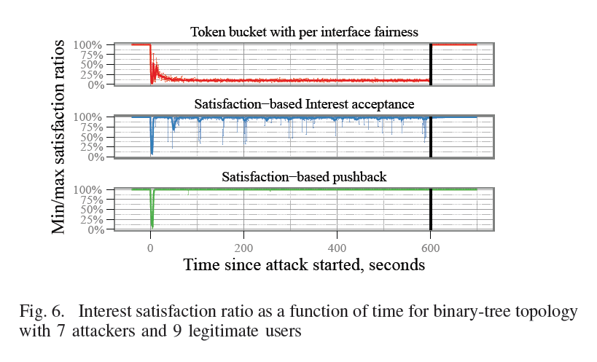
Evaluation of Interest Flooding Mitigation Methods (6/13)

Slide 30
Evaluation of Interest Flooding Mitigation Methods (7/13)
Network reaction to varying number of attackers
vary the percentage of attackers in the topology from 6% to over 50%.
as the number of attackers increases, the number of legitimate users decreases
All other parameters and experimental setup are consistent with the previous experiment

Slide 31
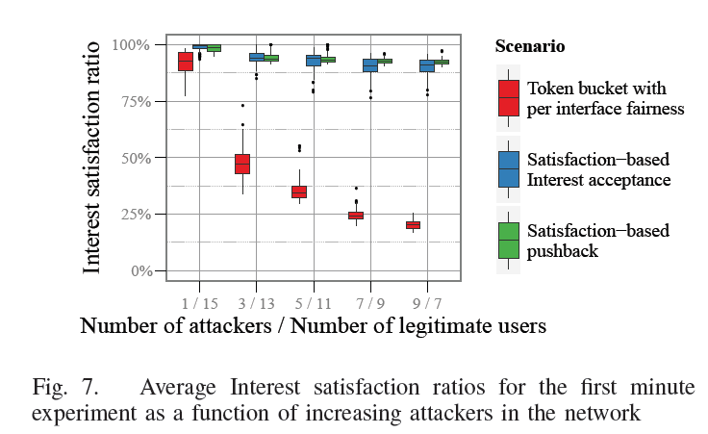
Evaluation of Interest Flooding Mitigation Methods (8/13)

Slide 32
Evaluation of Interest Flooding Mitigation Methods (9/13)
Large scale simulations
based on a modified version of Rocketfuel’s AT&T topology
extracted the largest connected component
comprising of 562 nodes
separated the nodes into three categories
Clients
Having degree less than four
Gateways
directly connected to clients
Backbones
the remaining nodes

Slide 33
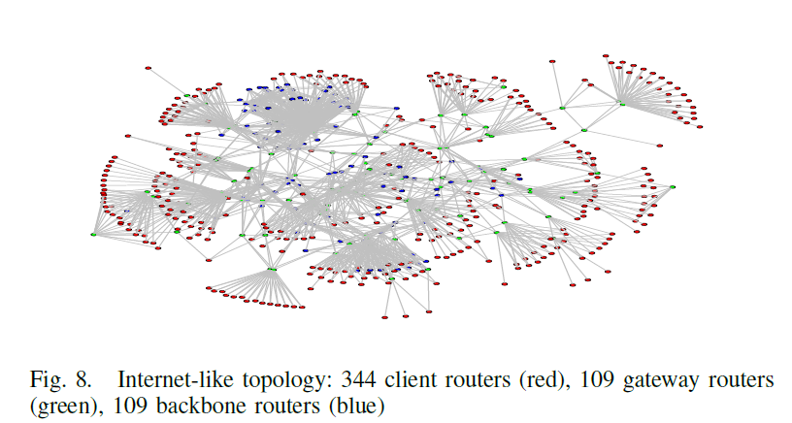
Evaluation of Interest Flooding Mitigation Methods (10/13)

Slide 34
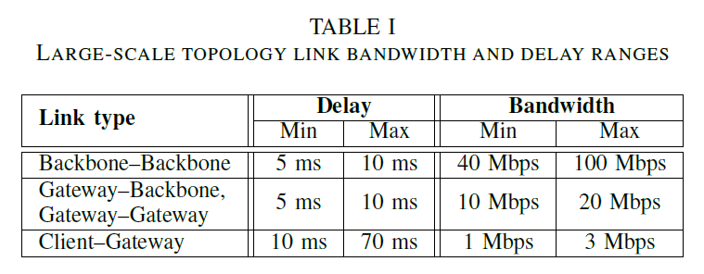
Evaluation of Interest Flooding Mitigation Methods (11/13)
Assigned bandwidth and delay values to links based on their type

Slide 35
Evaluation of Interest Flooding Mitigation Methods (12/13)
placing the data producer at both a gateway node as well as backbone node
fixed the number of malicious nodes at approximately 40%
140 out of 344 client nodes in the topology
the attack duration spanning a 5-minute interval.

Slide 36
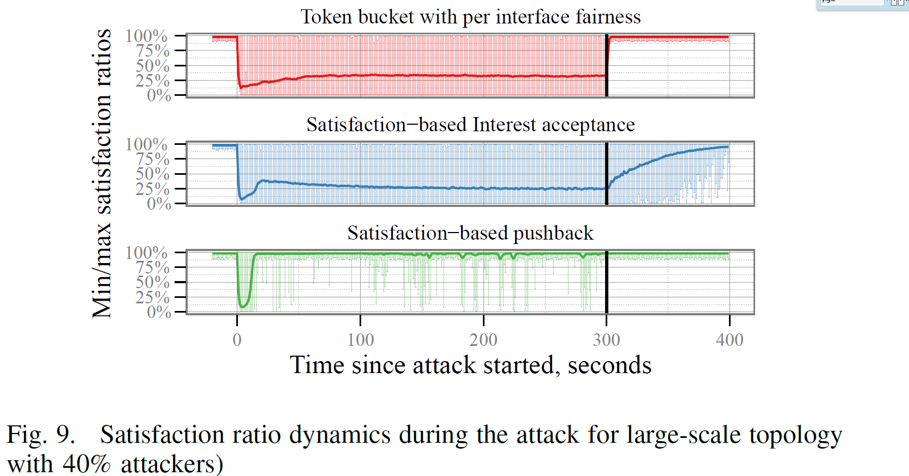
Evaluation of Interest Flooding Mitigation Methods (13/13)

